Slide 1
Cryptography in the "Post-AI" Era:
Machine Learning attacks on Post-Quantum Cryptosystems
Kristin Lauter
Senior Director, FAIR Labs North America
Meta
Joint work with*: Francois Charton, Mingjie Chen, Evrard Garcelon, Cathy Li, Mohamed Malhou, Nik Nolte, Eshika Saxena, Jana Sotakova, Sam Stevens, Ellie Thieu, Emily Wenger, Zeyuan Allen-Zhu
* combined author list from all papers, listed alphabetically

Slide 2
Cryptography…
The science of keeping secrets, protecting privacy, authenticating…
You use cryptography when
For secure browser sessions…
For encrypted messaging on What’sApp…

Slide 3
Machine Learning…
Artificial intelligence (AI) refers to
the science of utilizing data to formulate mathematical models that predict outcomes with high assurance.
Such predictions can be used to make decisions automatically or give recommendations with high confidence.

Slide 4
Talk outline:
What is Post-quantum cryptography (PQC)?
Lattice-based cryptography (LWE)
Machine Learning (AI) template—
how does it work?
Using AI to attack PQC: the SALSA approach
Benchmarking efforts

Slide 5
“Pre-Quantum Cryptography”
... is based on algebraic and number theoretic problems:
RSA based on hardness of factoring large integers
Diffie-Hellman based on hardness of discrete log in Zp*
Elliptic Curve Cryptography based on hardness of discrete log
This talk will focus on algebraic systems for Post-Quantum Cryptography, and AI/ML attacks on some of them.

Slide 6
The race for post-quantum cryptography
Full-scale quantum computers will break current public key encryption (RSA, ECC).
NIST competition (2017-2022) standardized schemes for post-quantum cryptography:
    Lattice-based
    Code-based
    Multivariate systems
    Supersingular Isogeny Graphs

Slide 7
Lattice-based cryptography
a PQC standard …

Slide 8
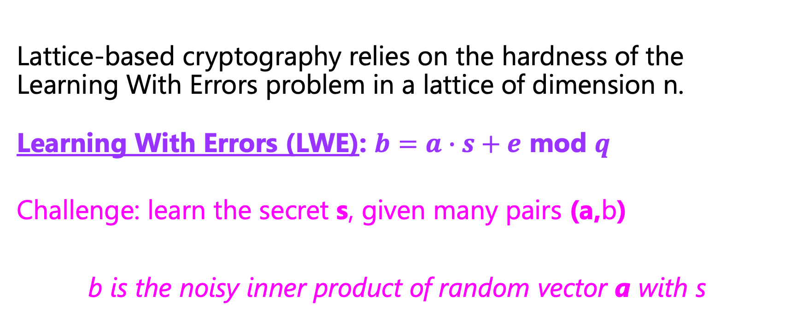
Lattice-based cryptography
Lattice-based cryptography relies on the hardness of the Learning With Errors problem in a lattice of dimension n.
Learning With Errors (LWE): $b=a∙s+e$ mod $q$
Challenge: learn the secret s, given many pairs (a,b)
b is the noisy inner product of random vector a with s

Slide 9
High-level Idea
Encryption:
  Encryption adds noise to a “secret” inner product
  Decryption subtracts the secret inner product and the noise becomes easy to cancel
Hard Problem:
  Hard problem is to “decode” noisy vectors
  If you have a short basis, it is easy to decompose vectors

Slide 10
LWE parameters
Hardness of LWE depends on selection of parameters:
  n = dimension of lattice (e.g. n=256, 512, 1024)
  q = modulus
  e = error vector, sampled from Gaussian with std deviation σ
  s = secret vector, sampled from secret distribution
  h = Hamming weight
  m = # samples (a, b = a.s+e) attacker has access to
Examples where LWE is not hard: q is too large compared to n.
LLL polynomial time (O~(n⁴)) algorithm finds s.

Slide 11
Examples of LWE in practice:
NIST 2022 PQC standard:
  Kyber 512, 768. RLWE with module structure, n=256, k = 2,3
  Log q =12
  Binomial secret distribution (for k=2, s_{i} = -2,-1,0,1, or 2)
  Small secret, but not sparse (e.g. ~37% zero bits)

Slide 12
Homomorphic Encryption Standard (HomomorphicEncryption.org 2018)
  Large dimension, n=1024, 2048, ... 2^{15}, 2^{16}
  Log q < 30 …
  Binary, ternary, Gaussian, random secret distributions
  Small error, σ ~ 3.2
  Some small secret distributions are standardized
  Sparse secrets not in standard, but used in practice (h=64)

Slide 13
Classical attacks on LWE…(we will come back to this)
Standards set by estimating classical lattice reduction attacks
  LLL, BKZ, fplll, BZK 2.0, … [LLL, Schnorr, Stehle, Chen-Nguyen, …]
  Using LWE Estimator [Albrecht-Player-Scott 2015 ++]
Concrete secret-recovery attacks: uSVP, decoding, dual
  All work by using lattice reduction to find the shortest vector or a “short enough” vector
BKZ improves LLL, increases blocksize, but exponential in blocksize
Could we use a different attack paradigm?

Slide 14
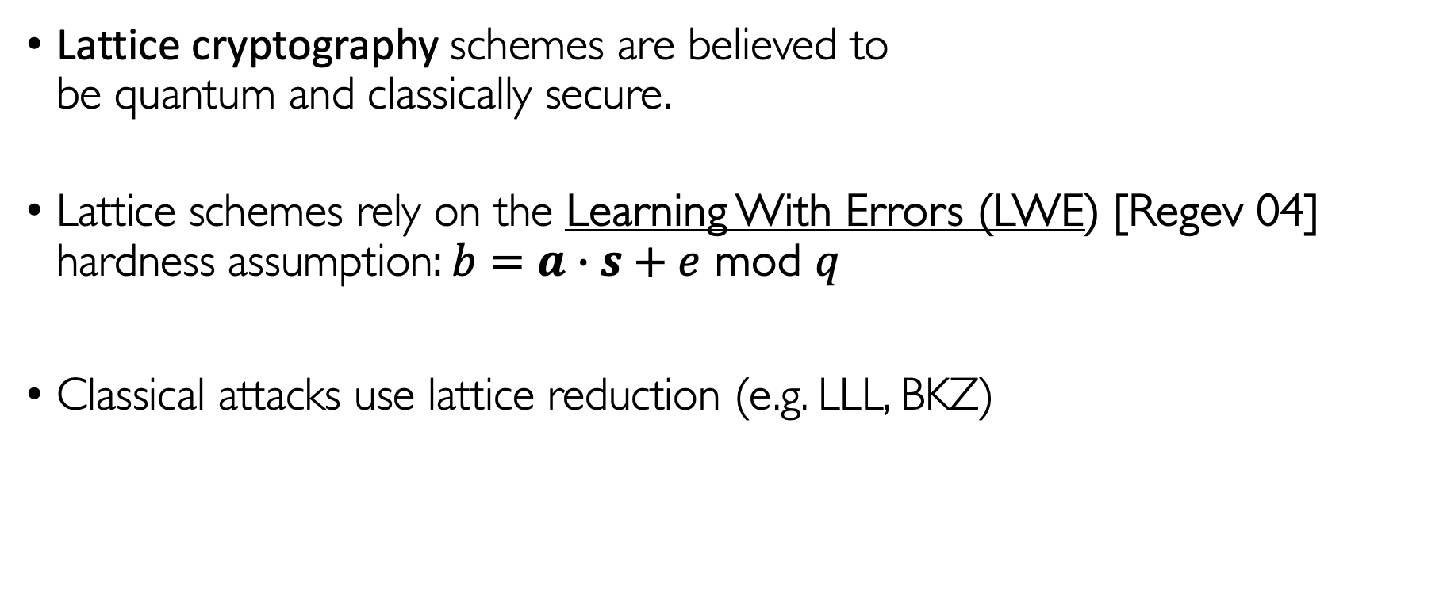
Lattice cryptography: a PQC standard
Lattice cryptography schemes are believed to
be quantum and classically secure.
Lattice schemes rely on the Learning With Errors (LWE) [Regev 04] hardness assumption: $b=a∙s+e$ mod $q$
Classical attacks use lattice reduction (e.g. LLL, BKZ)
Could we use a different attack paradigm?

Slide 15
Machine Learning
As a tool for cryptanalysis

Slide 16
Machine Learning for Predictive Modeling
Supervised Learning
  Training: derive a function (a model) from labeled training data
  Prediction: use the “learned” function (model) to make predictions on new data
Training data is represented as vectors.
  Real-world information is “encoded” as a vector:
  Personal profiles with 200 characteristics
  History of movie preferences
  History of credit card purchases
  Genomic sequences as SNPs

Slide 17
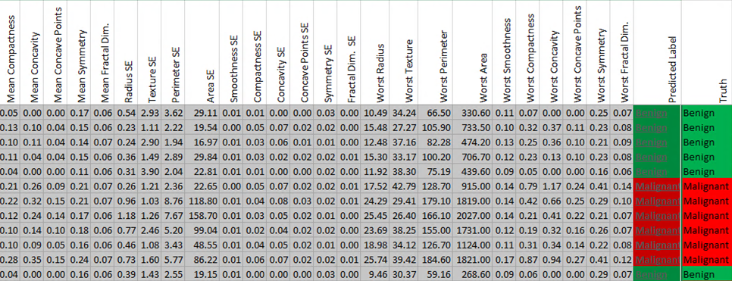
Predictions on Medical data

Slide 18
Linear Means Classifier (binary)
Divide training data into (two) classes according to their label
Compute mean vectors for each class
Compute difference between means
Compute the midpoint
Define a hyperplane between the means, separating the two classes

Slide 19
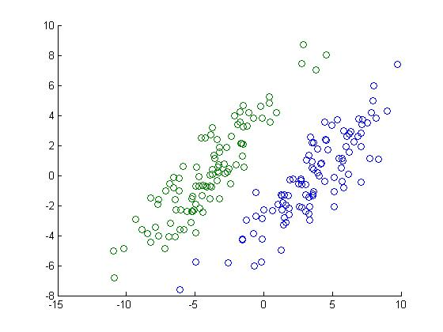
Binary classification example

Slide 20
Machine Learning (ML)/Artificial Intelligence(AI)
Strategy (for supervised learning):
Given a set of labelled data (binary labels)
Compute a “model” which is a decision boundary (like a hyperplane).
Define a “loss function” such as least squares distance (sum of distances to the boundary)
Step by step, proceed to “minimize” the loss function, for example through Stochastic Gradient Descent (Multivariable calculus!)
Models:
Linear regression
Logistic regression
…
Deep Neural Nets
Transformers

Slide 21

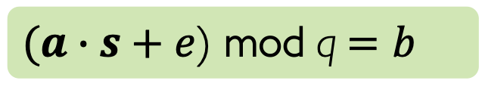
Use Machine Learning (ML) to attack LWE?
Learning with errors (LWE)
LWE attack goal
$(a∙s+e$) mod q$=b$
Given LWE samples {$\left(a, b\right)\}$, recover $s.$
Key attack intuitions
LWE assumes learning from noisy data is hard;
but ML models are good at learning from noisy data!
LWE is like linear regression but modulo q!
ML models can do other math, but not good at modular arithmetic!

Slide 22
SALSA: Verde, Picante, y Fresca
4 papers on ML cryptanalysis of LWE: 2022—2024

Slide 23
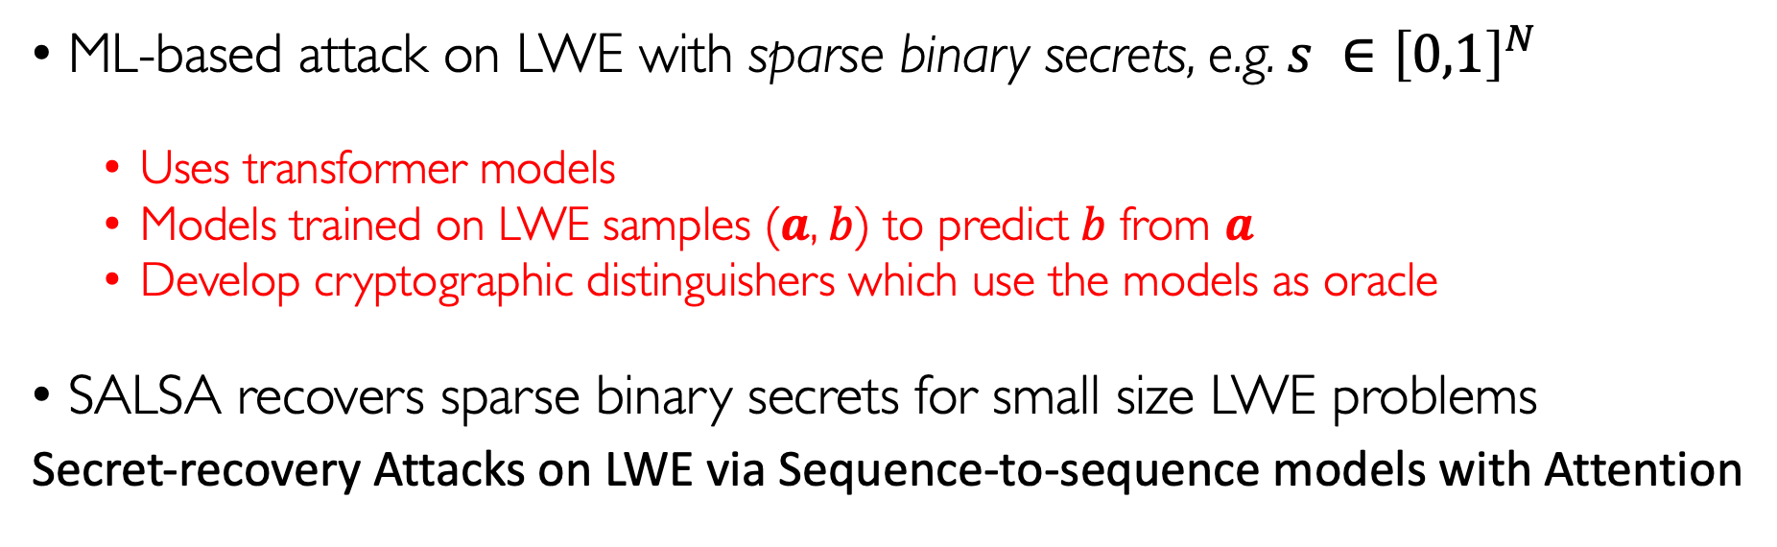
Our initial work: SALSA [WCCL NeurIPS 2022]
ML-based attack on LWE with sparse binary secrets, e.g. $s ∈{\left[0,1\right]}^{N}$
  Uses transformer models
  Models trained on LWE samples ($a$, $b$) to predict $b$ from $a$
  Develop cryptographic distinguishers which use the models as oracle
SALSA recovers sparse binary secrets for small size LWE problems
Secret-recovery Attacks on LWE via Sequence-to-sequence models with Attention
SALSA: Attacking Lattice Cryptography with Transformers, Wenger et al, NeurIPS 2022

Slide 24
SALSA ingredients
🧅 Transformer model
🫑 Secret recovery 🌶
🍅 Secret verification
→ train model on many LWE samples
→ extract secret prediction from model
→ check if secret is correct

Slide 25
SALSA performance
SALSA can successfully recover sparse, binary secrets for small LWE problems
SALSA recovers secrets when model starts to learn
High accuracy not needed for secret recovery
secret recovered!
Model accuracy/loss on (R)LWE problems with Hamming weight 3

Slide 26
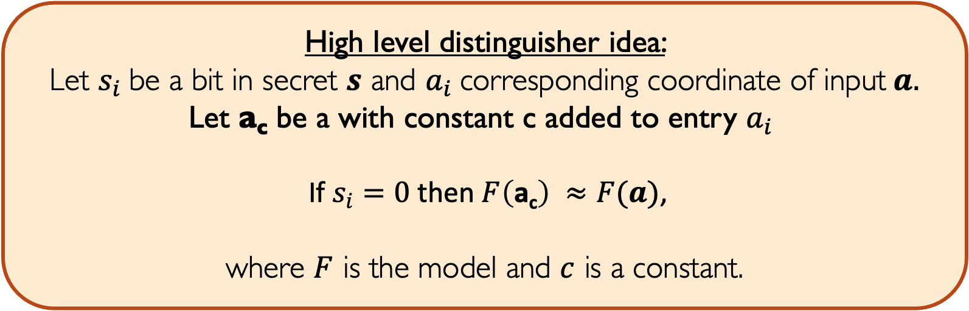
Secret Distinguishers
3 distinguishers enable secret recovery from trained model F.
Recall: F(a) is the model’s prediction for b
  Direct
  Distinguisher
  Cross-attention [Picante]
High level distinguisher idea:
Let $s_{i}$be a bit in secret $s$ and $a_{i}$corresponding coordinate of input$a.$
Let a_{c} be a with constant c added to entry $a_{i}$
If $s_{i}=0$then $F\left(\text{a}\text{c}\right) ≈F(a)$,
where $F$ is the model and $c$ is a constant.

Slide 27
Key limitations of SALSA
Significant data requirements (4 million LWE samples)
Small dimension (best n=128)
Low Hamming weight (best h=5)
Binary secrets only
Our subsequent work, PICANTE, VERDE, Fresca address these limitations.
Now, SALSA attacks are closer to attacking real-world systems.

Slide 28
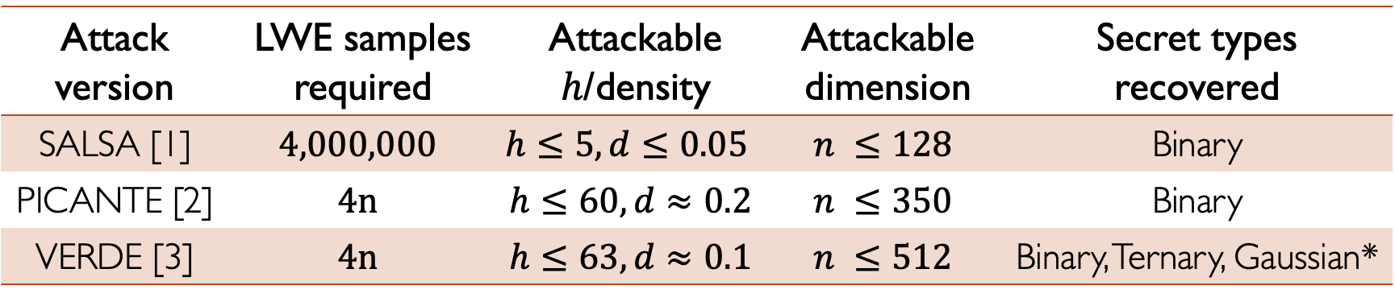
SALSA: PICANTE, VERDE
Attack version | LWE samples required | Attackable $h$/density | Attackable dimension | Secret types recovered
SALSA [1] | $$4,000,000$$ | $$h≤5, d≤0.05$$ | $$n ≤128$$ | Binary
PICANTE [2] | $$4n$$ | $$h≤60,d≈0.2$$ | $$n ≤350$$ | Binary
VERDE [3] | $$4n$$ | $$h≤63,d≈0.1$$ | $$n ≤512$$ | Binary, Ternary, Gaussian*
[1] SALSA: Attacking Lattice Cryptography with Transformers, Wenger et al, NeurIPS 2022
[2] SALSA PICANTE: a machine learning attack on LWE with binary secrets, Li et al, CCS 2023
[3] SALSA VERDE: a machine learning attack on Learning with Errors with sparse small secrets, Li et al, NeurIPS 2023

Slide 29
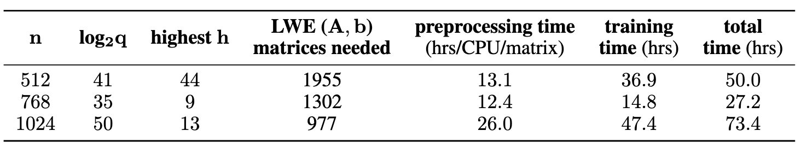
SALSA Fresca
[Stevens et al, Jan’24]
Angular embedding to mimic mod q arithmetic
Pre-training to reduce reliance on # of samples needed to train
Faster pre-processing using flatter, with polishing and BKZ

Slide 30
Benchmarking LWE Attacks
See: https://github.com/facebookresearch/LWE-benchmarking.
Key contributions:
  Implementation/evaluation of ML and classical attacks on Kyber and HE
Additional future work:
  Improve ML attacks to recover general secrets

Slide 31
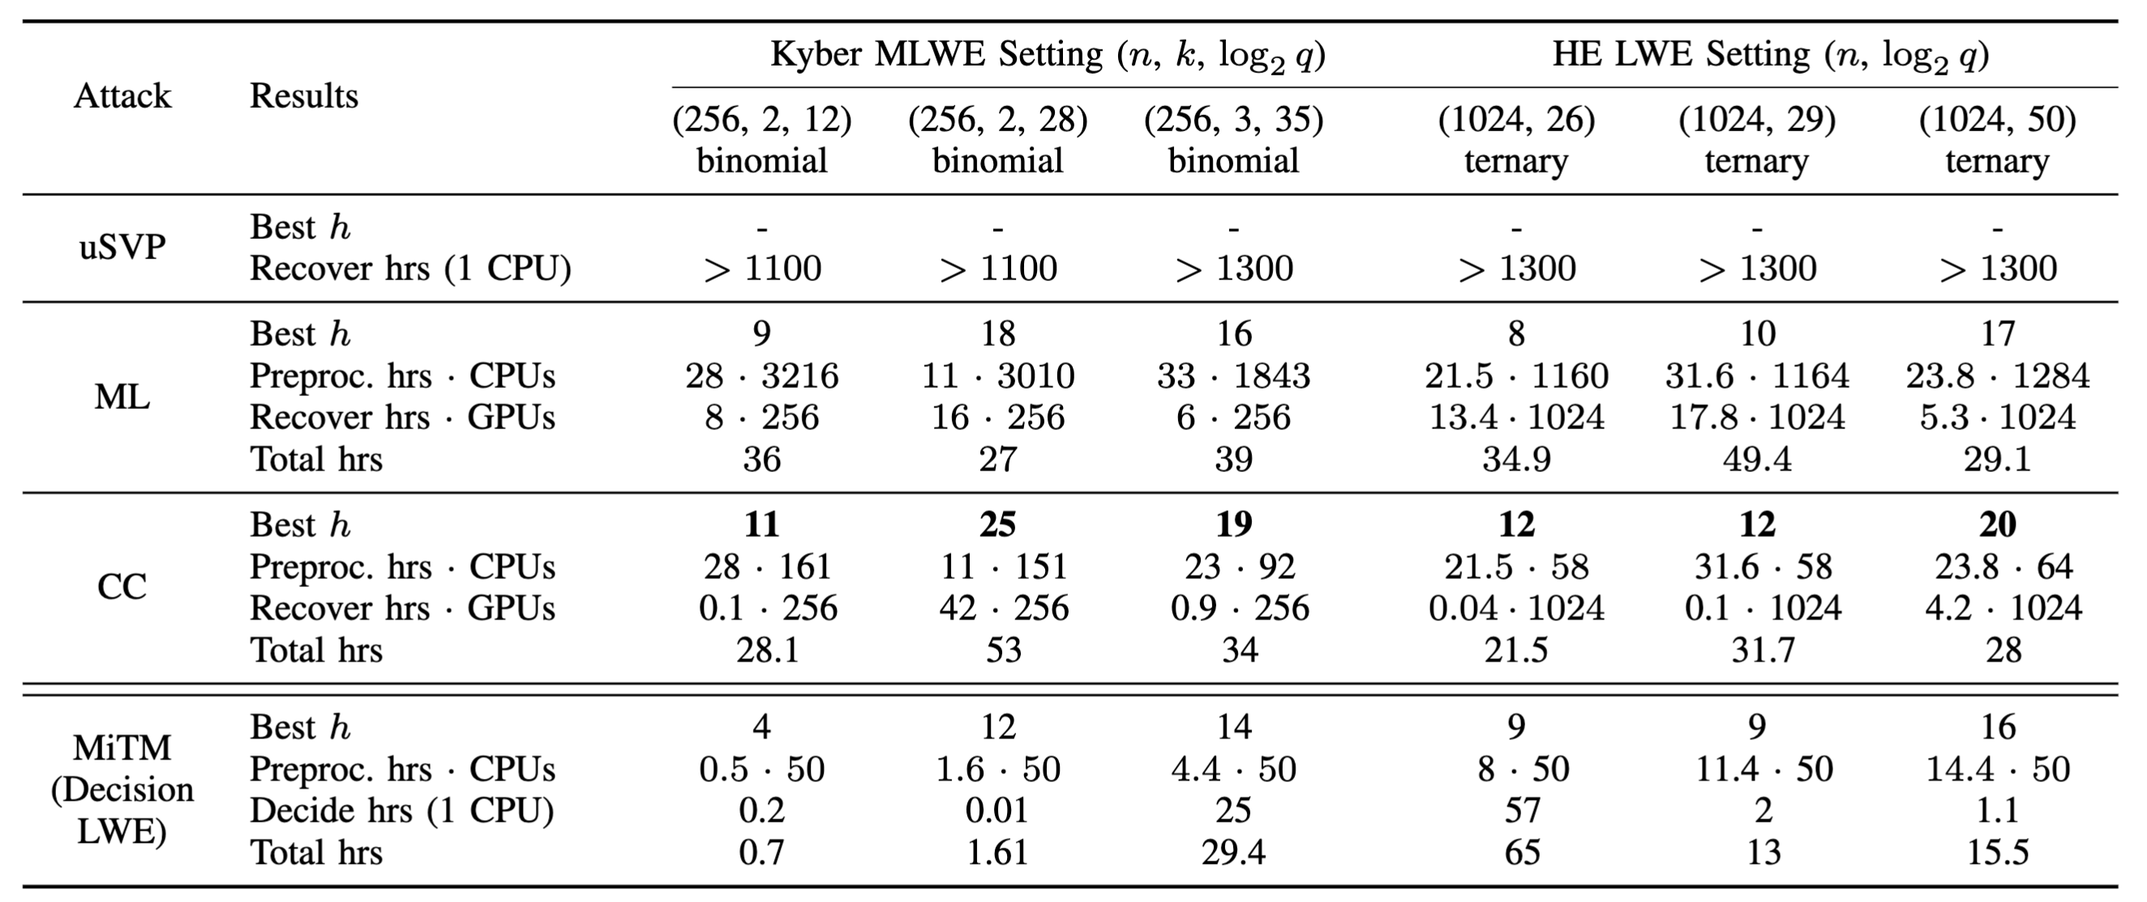
Results on benchmark settings
Notes:
TODO

Slide 32
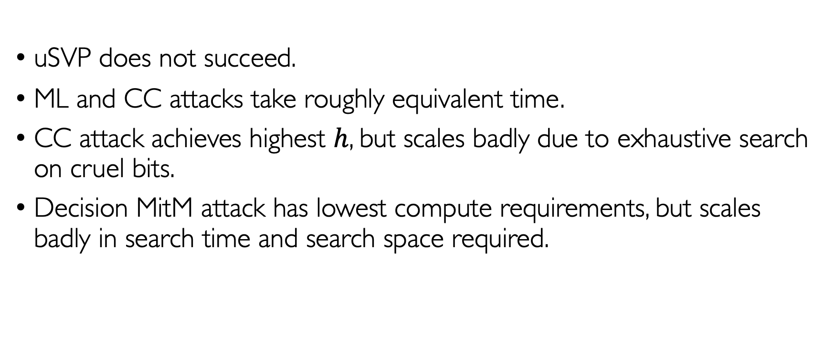
Takeaways from benchmark experiments
uSVP does not succeed.
ML and CC attacks take roughly equivalent time.
CC attack achieves highest $h$, but scales badly due to exhaustive search on cruel bits.
Decision MitM attack has lowest compute requirements, but scales badly in search time and search space required.

Slide 33
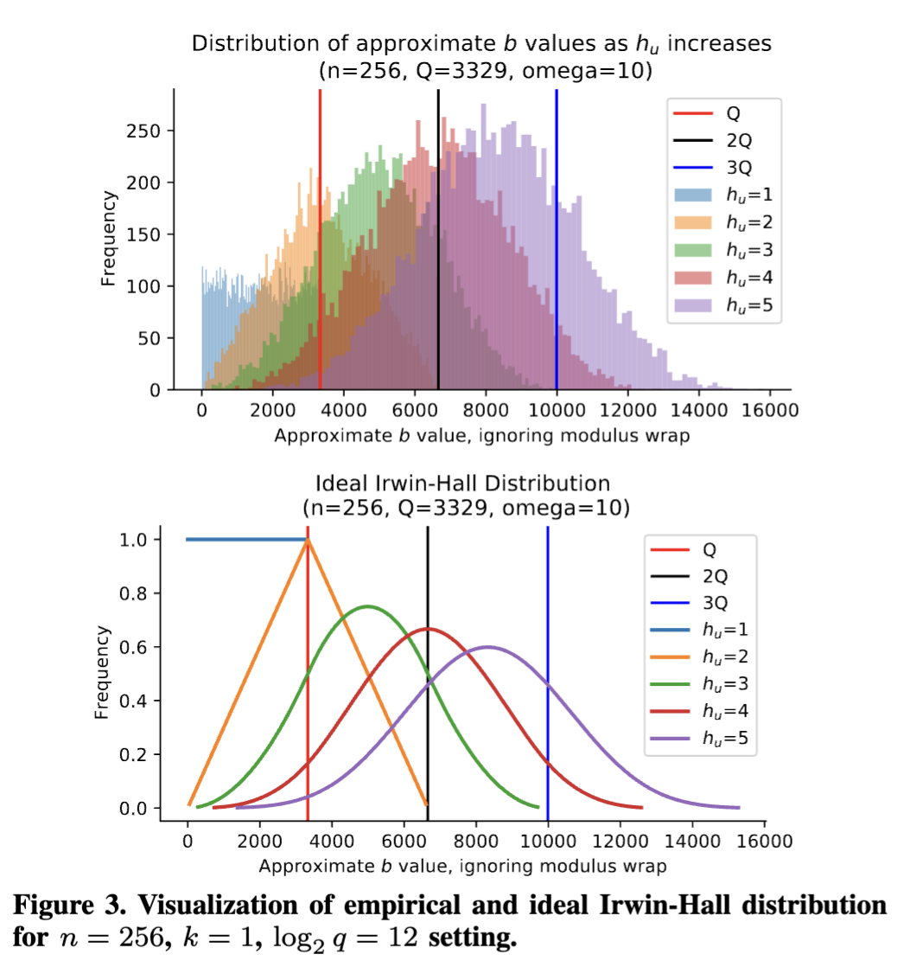
ML attacks recover up to 3 cruel bits
Applying CC insights to ML attack, we found ML models recover secrets with at most 3 cruel bits.
Sums of uniform random (cruel) elements follow Irwin-Hall distribution – see distribution.
This implies that ML models struggle with modular arithmetic – more work needed.

Slide 34
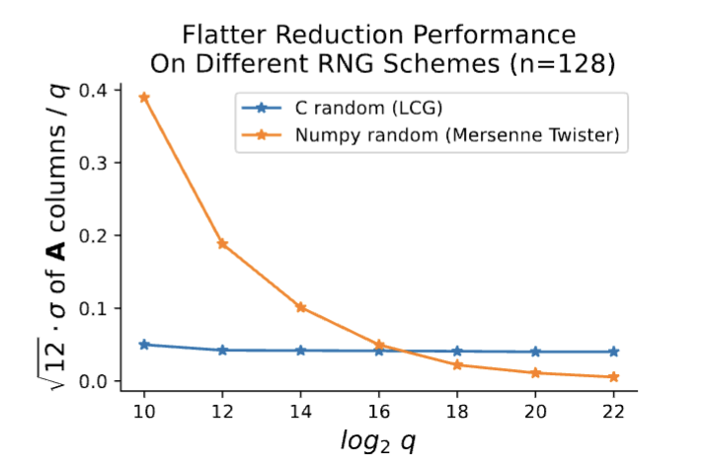
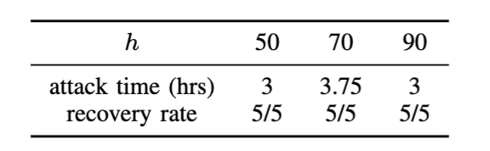
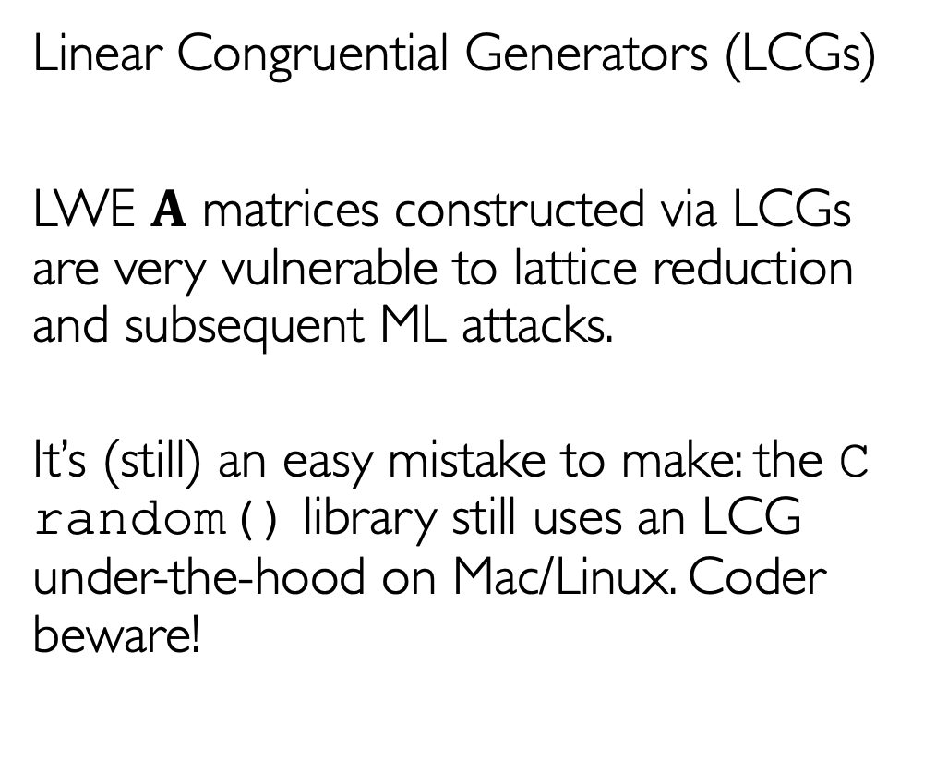

Bad RNGs make LWE attacks very easy
Linear Congruential Generators (LCGs)
LWE $A$ matrices constructed via LCGs are very vulnerable to lattice reduction and subsequent ML attacks.
It’s (still) an easy mistake to make: the C random() library still uses an LCG under-the-hood on Mac/Linux. Coder beware!
ML attack performance on LCG-generated data
($n=256$, $logq=12,$varying $h)$

Slide 35
Conclusion:
We are now in a “Post-AI” Era, where we need to understand robustness of cryptographic hardness assumptions to AI (ML) algorithms, not just to quantum algorithms (of the future).

Slide 36
Related work
AI4Math
  F. Charton: Learning linear algebra, gcd, modular arithmetic …
  Saxena-Alfarano-Wenger-L: Teaching transformers modular addition at scale
  Malhou-Perret-L: AI for Code-based Crypto
  Kaiyu Yang et al: Formal Mathematical Reasoning: A New Frontier in AI
  WIN6 project: Machine Learning for Modular Multiplication,
  K. Lauter, Cathy Li, Krystal Maughan, Rachel Newton, Megha Srivastava

Slide 37
Questions?

Slide 38
From 4,000,000 to 4n samples
PICANTE and VERDE run a novel preprocessing step to improve data efficiency.

Slide 39
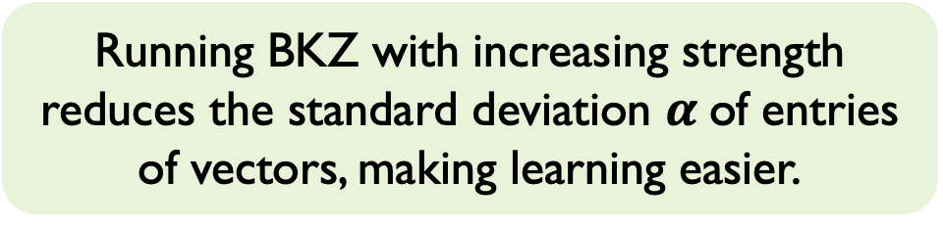
Reducing Standard deviation: a new approach to processing samples
Preprocessing reduces the standard deviation of the coordinates of $a$ !
Running BKZ with increasing strength reduces the standard deviation $α$of entries of vectors, making learning easier.
legend = BKZ (delta, block size)

Slide 40

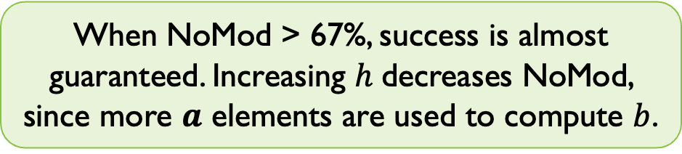
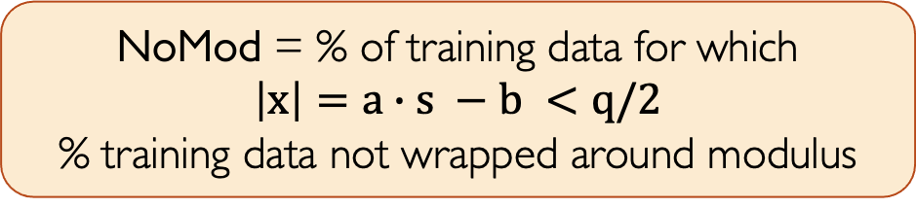
Increasing attackable $Hamming weight h$
NoMod results suggest range of attackable $h$ based on training data property.
NoMod = % of training data for which
$\left|x\right|=a∙s −b <q/2$
% training data not wrapped around modulus
When NoMod > 67%, success is almost guaranteed. Increasing $h$decreases NoMod, since more $a$ elements are used to compute $b$.
But note, distribution does not need to be centered at 0, it just needs to be concentrated!

Slide 41
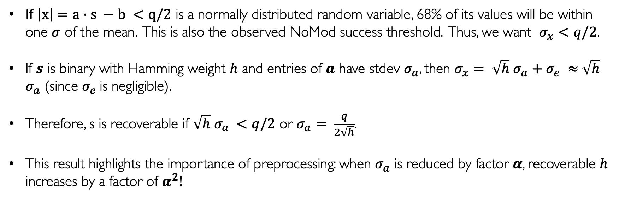
Understanding impact of mod q arithmetic
Theory result: $σ$ of training data determines recoverable $h$.
If $\left|x\right|=a∙s −b <q/2$ is a normally distributed random variable, 68% of its values will be within one $σ$ of the mean. This is also the observed NoMod success threshold. Thus, we want $σ_{x}<q/2$.
If $s$ is binary with Hamming weight $h$ and entries of $a$ have stdev $σ_{a}$, then $σ_{x}= \sqrt{h}$ $σ_{a}+σ_{e} ≈$ $\sqrt{h}$ $σ_{a}$ (since $σ_{e}$is negligible).
Therefore, s is recoverable if $\sqrt{h}$ $σ_{a} <q/2$ or $σ_{a}= \frac{q}{2\sqrt{h}}$.
This result highlights the importance of preprocessing: when $σ_{a}$ is reduced by factor $α$, recoverable $h$ increases by a factor of $α^{2}!$

Slide 42
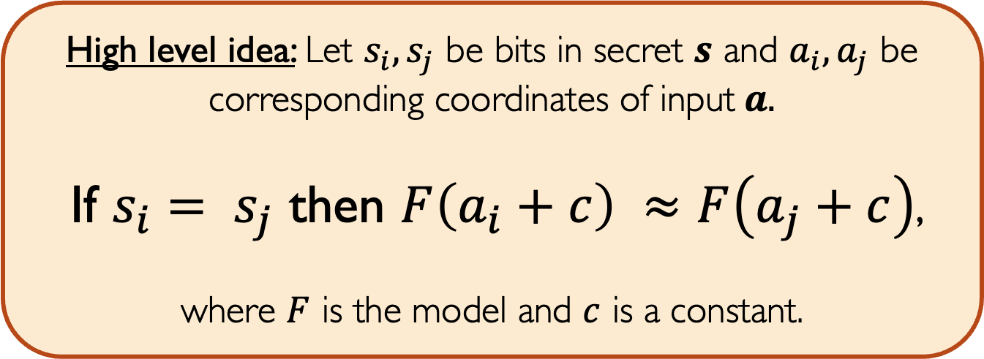
Recovering ternary secrets
Our novel two-bit distinguisher enables recovery of more complex secrets.
High level idea: Let $s_{i}, s_{j}$ be bits in secret $s$ and $a_{i}, a_{j}$ be corresponding coordinates of input$a.$
If $s_{i}= s_{j}$ then $F\left(a_{i}+c\right) ≈F\left(a_{j}+c\right)$,
where $F$ is the model and $c$ is a constant.

Slide 43
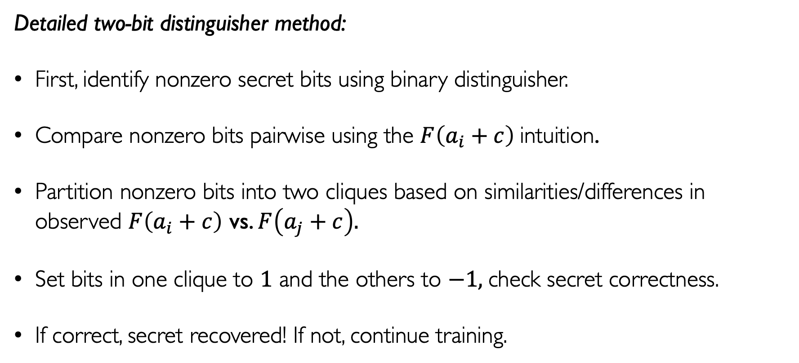
Recovering ternary secrets
(s_{i} in {-1,0,1})
Detailed two-bit distinguisher method:
First, identify nonzero secret bits using binary distinguisher.
Compare nonzero bits pairwise using the $F\left(a_{i}+c\right)$intuition.
Partition nonzero bits into two cliques based on similarities/differences in observed $F\left(a_{i}+c\right)$ vs. $F\left(a_{j}+c\right).$
Set bits in one clique to $1$ and the others to $−1,$check secret correctness.
If correct, secret recovered! If not, continue training.

Slide 44
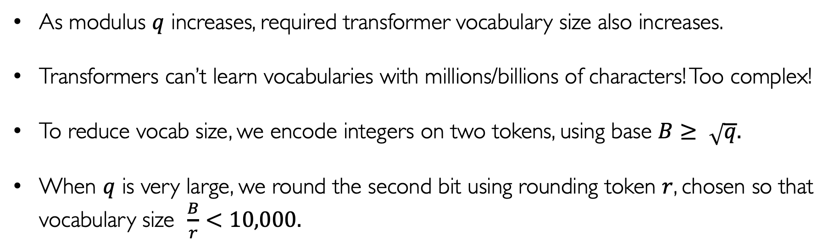
Scaling up dimension
We improve our choice of encoding base to attack larger dimensions.
As modulus $q$ increases, required transformer vocabulary size also increases.
Transformers can’t learn vocabularies with millions/billions of characters! Too complex!
To reduce vocab size, we encode integers on two tokens, using base $B≥ \sqrt{q}.$
When $q$ is very large, we round the second bit using rounding token $r$, chosen so that vocabulary size $\frac{B}{r}<10,000.$

Slide 45
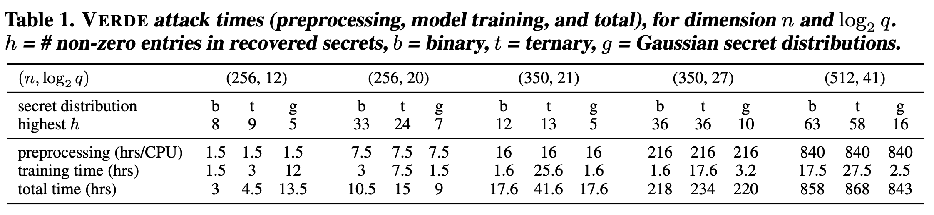
SALSA Verde
[Li et al, NeurIPS23]
Theoretical modeling of impact of mod q arithmetic
More general small secrets: binary, ternary, Gaussian
Model architecture improvement: encoder only

